Slide 1

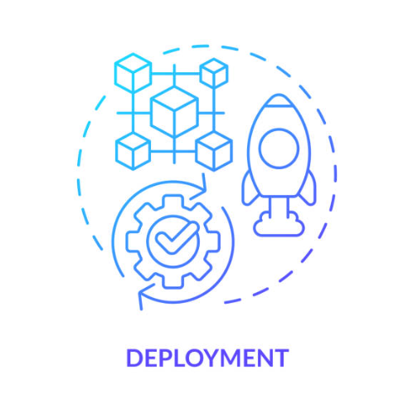
Understanding Deployment – How Flask Apps Go Live

Slide 2
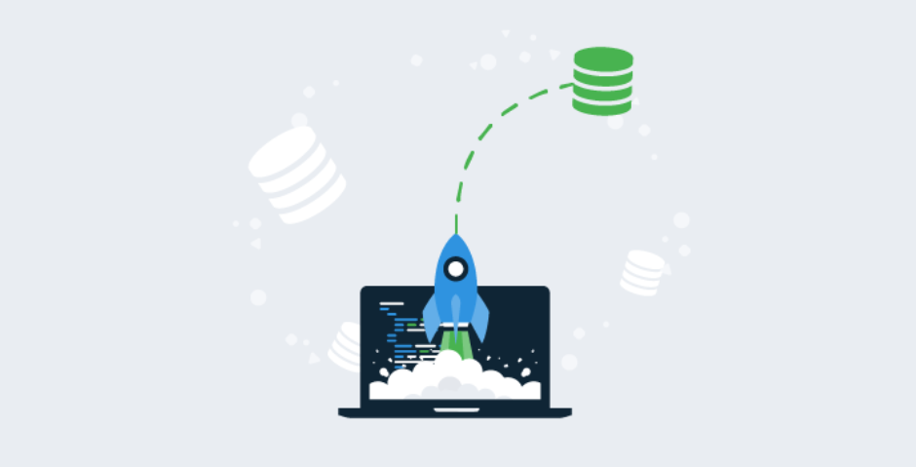
Topics :
What is deployment?
How deployment is useful in Data Science?
Overview of deployment stack.

Slide 3
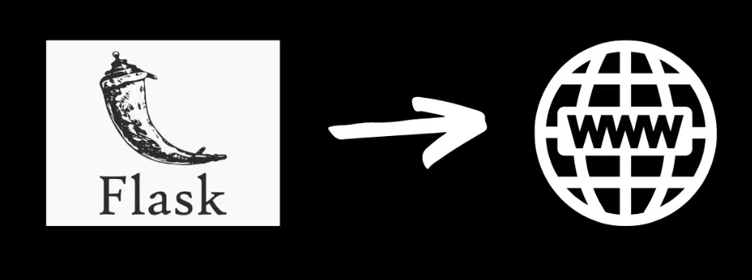
1. What is deployment?
Deployment means making your web application (like your Flask app) live on the internet so that other people can use it — not just on your computer.
For example, if you've built a machine learning model in Flask, deployment means putting it online so users can send requests and get predictions from anywhere in the world.

Slide 4
1. What is deployment?
Analogy:
Think of it like writing a document in MS Word (your local system). Deployment is like uploading it to Google Docs so your friends or coworkers can access it anytime.

Slide 5
2. How deployment is useful in Data Science?
In data science, we often build models (e.g., to predict prices, detect spam,
or classify images).
But just building the model isn't enough — we need to share it with real
users or clients.
Deployment allows:
Others (users, apps, businesses) to use your model via a web interface or API
Integration into websites, mobile apps, or automation systems
Continuous feedback from users to improve the model

Slide 6
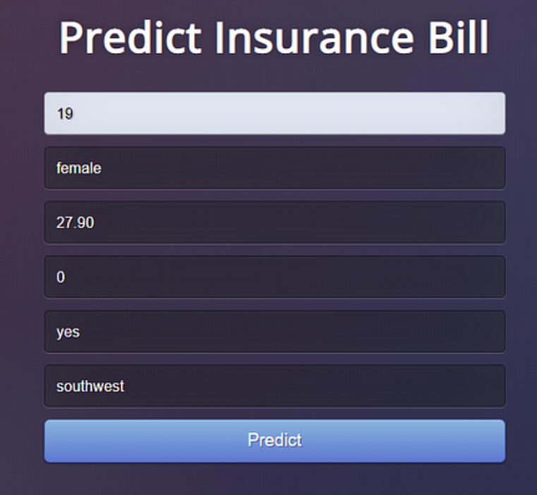
2. How deployment is useful in Data Science?
Example:
You built a model to predict Insurance Bill.
By deploying it, a user can visit a web page,
enter bill details, and get a bill
instantly — powered by your model.

Slide 7
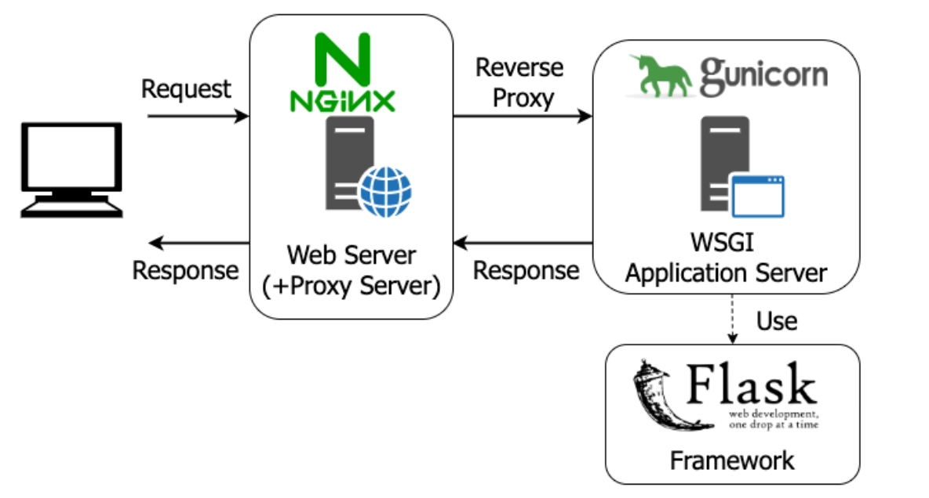
3. Overview of deployment stack.
A deployment stack is like a set of
tools and technologies that work
together to make your app live and
usable online.

Slide 8
3. Overview of deployment stack.
Deployment stack for Flask may look like :
Layer | Tool / Technology | Purpose
Application | Flask (Python) | The core app (routes, logic, model)
Server | Gunicorn or uWSGI | Runs your Flask app in production
Web Server | Nginx or Apache | Handles incoming web traffic and sends it to your Flask app
Cloud Platform | Render, Heroku, AWS, etc. | Hosts your app online
Domain (optional) | GoDaddy, Namecheap, etc. | A human-readable URL (like myapp.com)

Slide 9

3. Overview of deployment stack.
Application Server (Gunicorn) :
Flask’s built-in server (flask run) is not suitable for production.
Tools like Gunicorn or uWSGI wrap around your Flask app and make it faster and more stable.

Slide 10
3. Overview of deployment stack.
Application Server (Gunicorn) :
Gunicorn is a Python Web Server Gateway Interface (WSGI) HTTP server used to serve Python web applications like Flask and Django. It acts as a bridge between the web server and your application, handling incoming requests and passing them to the appropriate application for processing. Gunicorn is particularly useful for production environments because it can handle multiple concurrent requests, ensuring high performance and scalability.

Slide 11
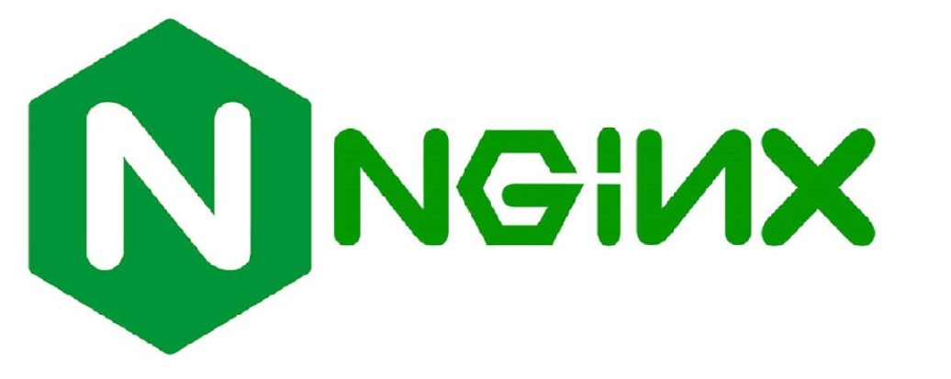
3. Overview of deployment stack.
Web Server (Nginx)
A web server like Nginx:
        Nginx is a fast, production level HTTP server.
        Accepts incoming requests (e.g., from browsers or Postman)
        Forwards them to Gunicorn

Slide 12
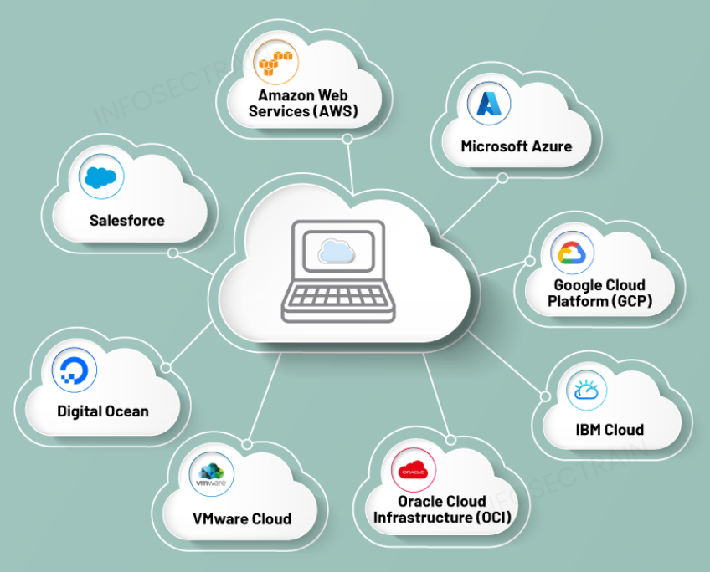
3. Overview of deployment stack.
Cloud Hosting (Render/Heroku/AWS/etc.)
You deploy your Flask app and model to a cloud platform.
The platform automatically connects everything:
    Gunicorn
    Web server
    App environment
    You get a public URL to share with others
    (e.g., https://flask-predictor.onrender.com)

Slide 13
Thanks!

